Slide 1


Slide 2
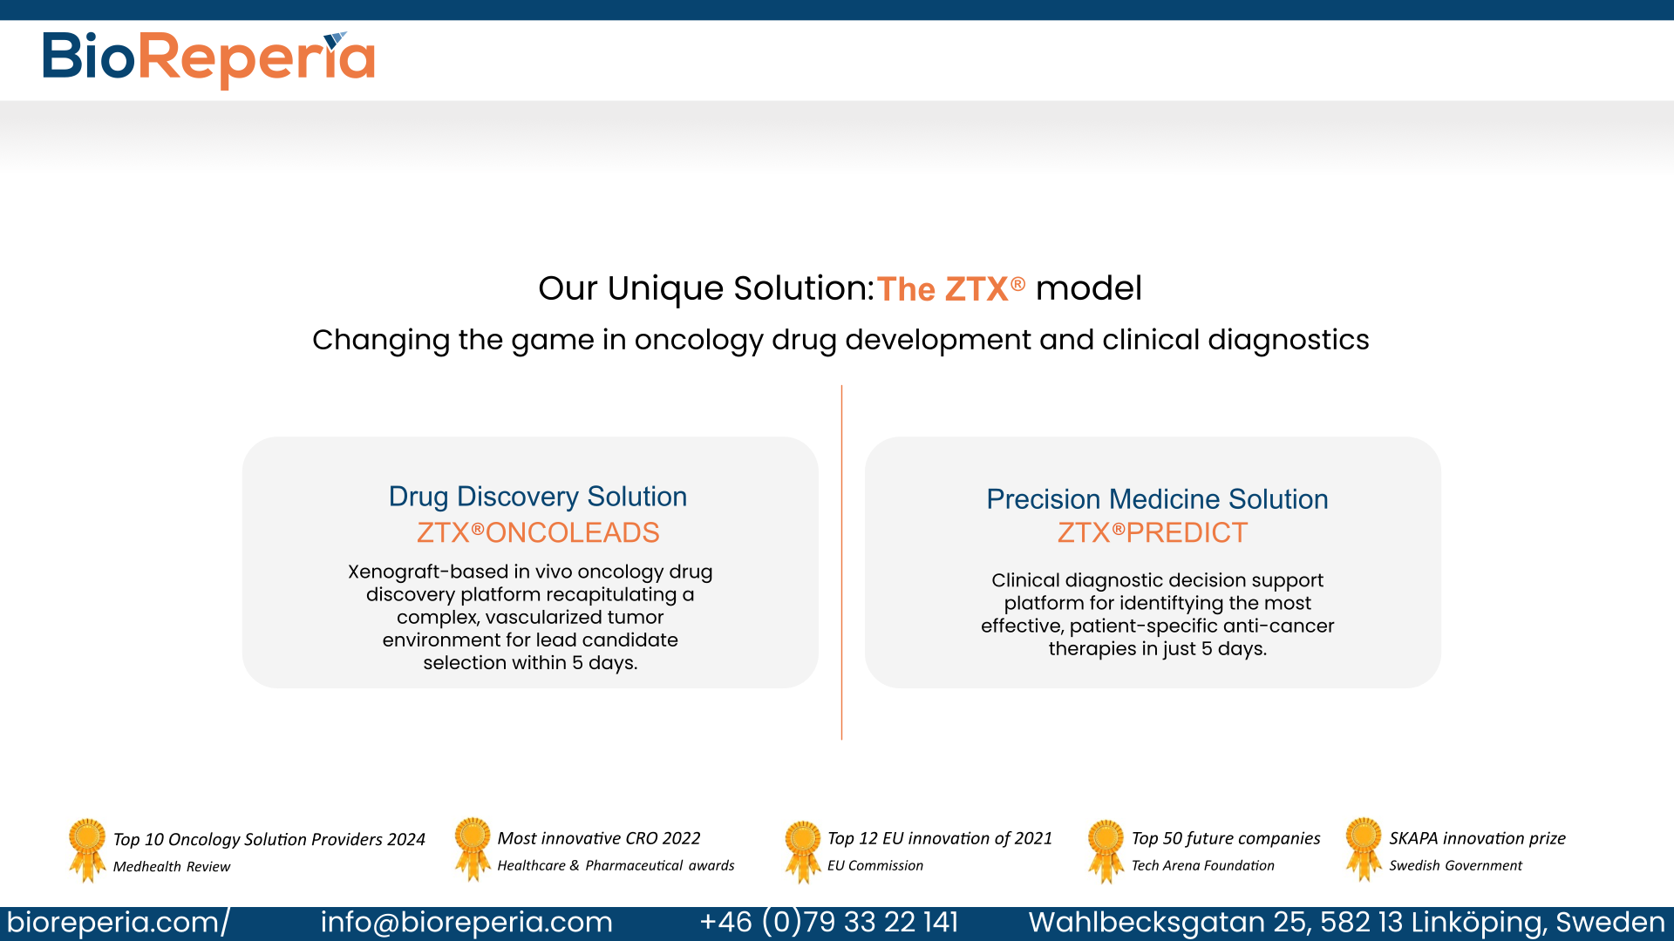
Notes:
I thought that it would be good to introduce both platforms to showcase our breadth of expertise.
The repeated banner of awards is intentional, in case they missed it the first slide.

Slide 3
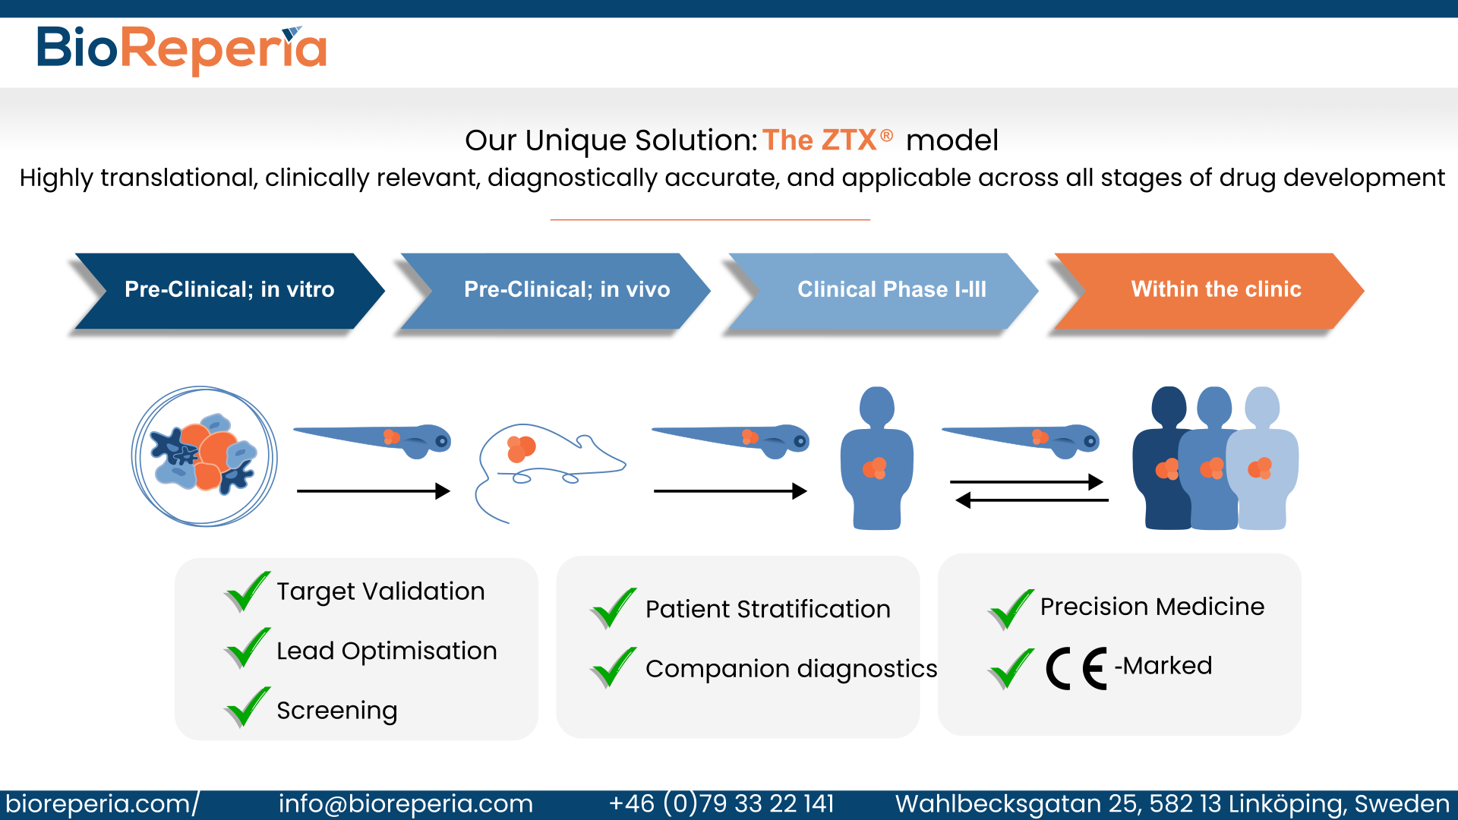
Notes:
This is the same content as the last version, but I just tidied it up a bit and made it all a bit clearer/ more visually appealing.

Slide 4
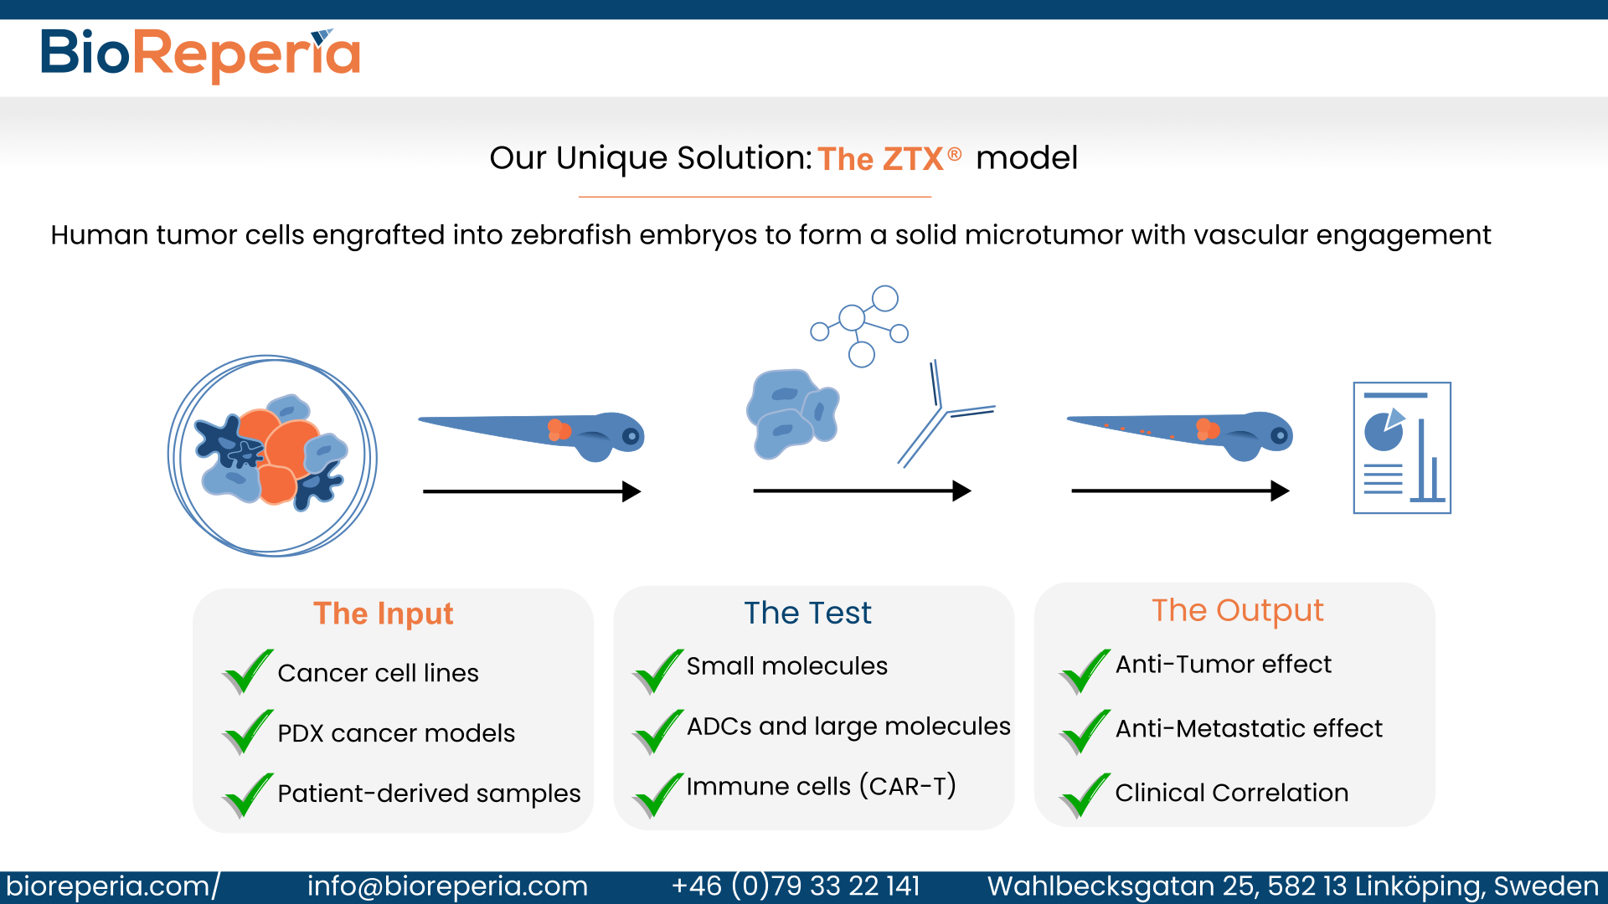
Notes:
This shows a simple and typical workflow with the input, test and output explicitly highlighted. I didn’t think it was necessary to have so much technical details in the first meeting. It is more important that the client can see what they can use (input), what they can test, and what they will get out of the study (output).

Slide 5
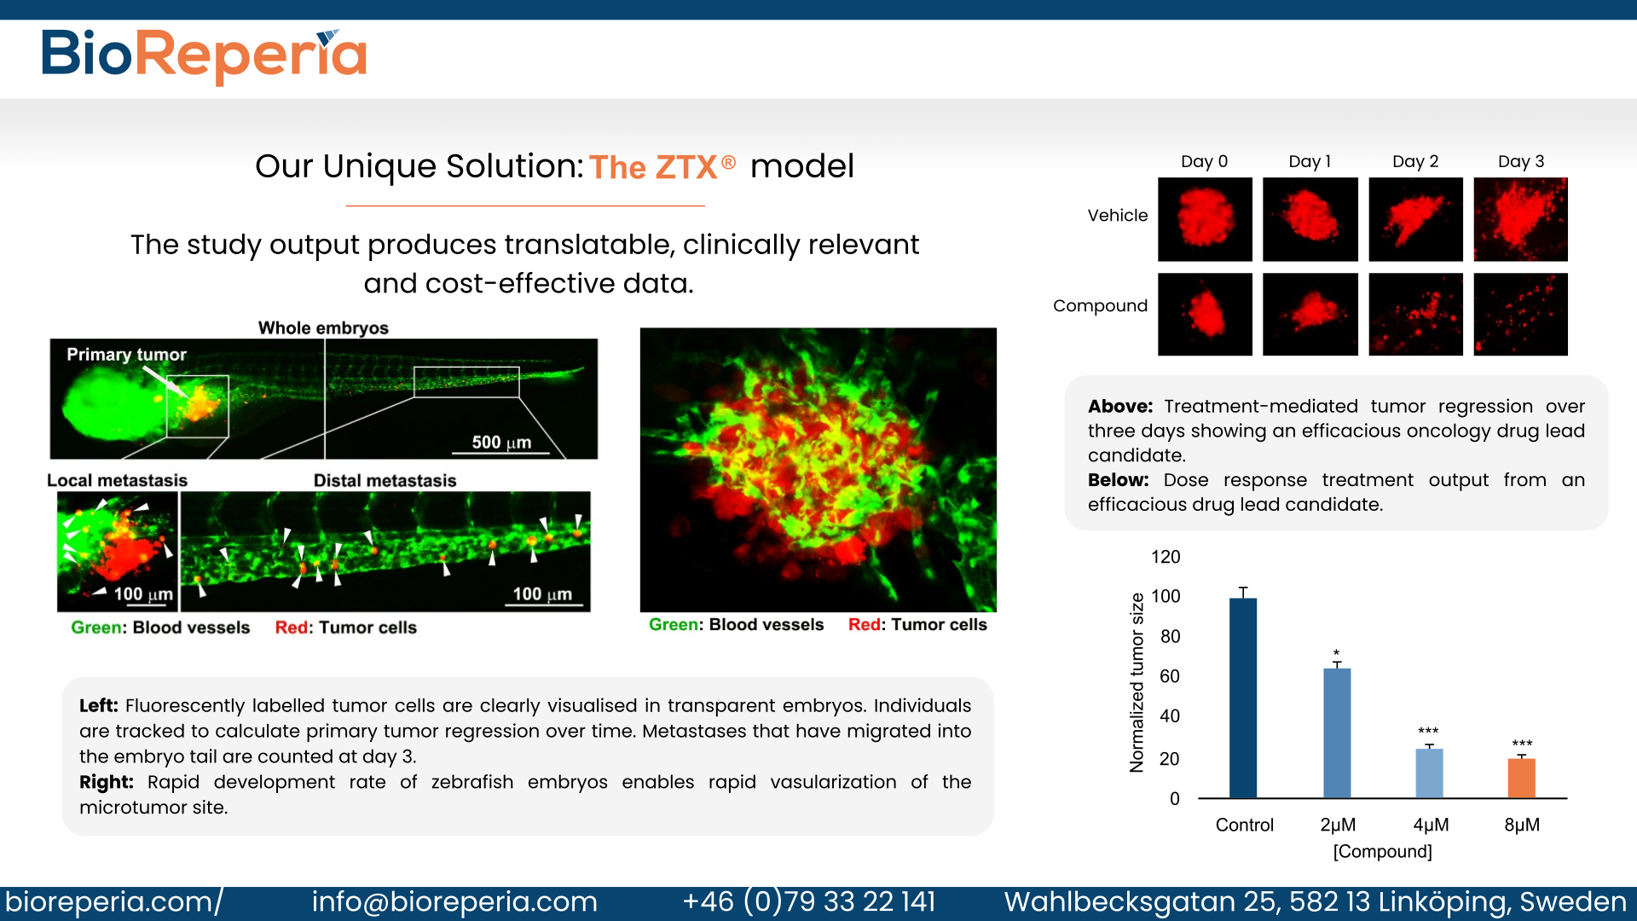
Notes:
The final slide that shows the clear output (images and data). I thought it was best to have it all on one slide, then we can start the discussion and leave this slide up as we answer questions and put our answer into context.

